Slide 1
REDUX Tutorial
Chapter 01
Presented by
Md Ariful Islam
MSc(CE), Ude, Germany

Slide 2
Outline
Background& Motivation (Why Redux)
Redux Basic
Implementation (e.g Fetch data fromAPI using jsonp)
Assumption: knows JS, ReactJS, NPM

Slide 3
Why Redux?
Managing the state of your data (state-transfer-problem)
Predictable state mutation (how and when updates can happen)
Notes:
State-transfer-problem: React use one way of data flow among components. go to next slide.

Slide 4

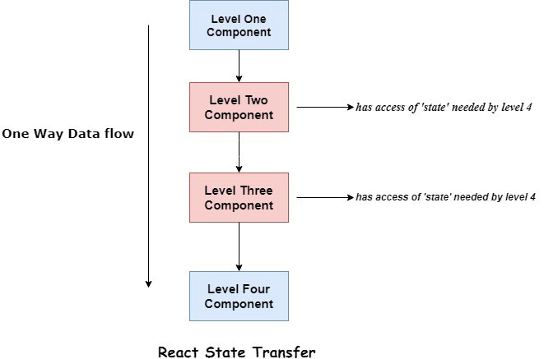
State-transfer-problem: React
React: Unnecessary data transfer
Redux: All state in store

Slide 5
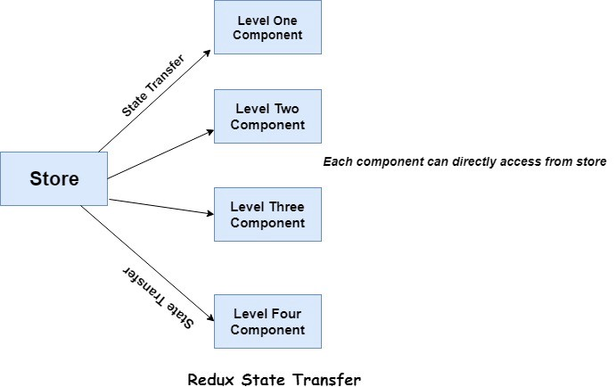
State-transfer-problem: React
React: Unnecessary data transfer
Redux: All state in store

Slide 6
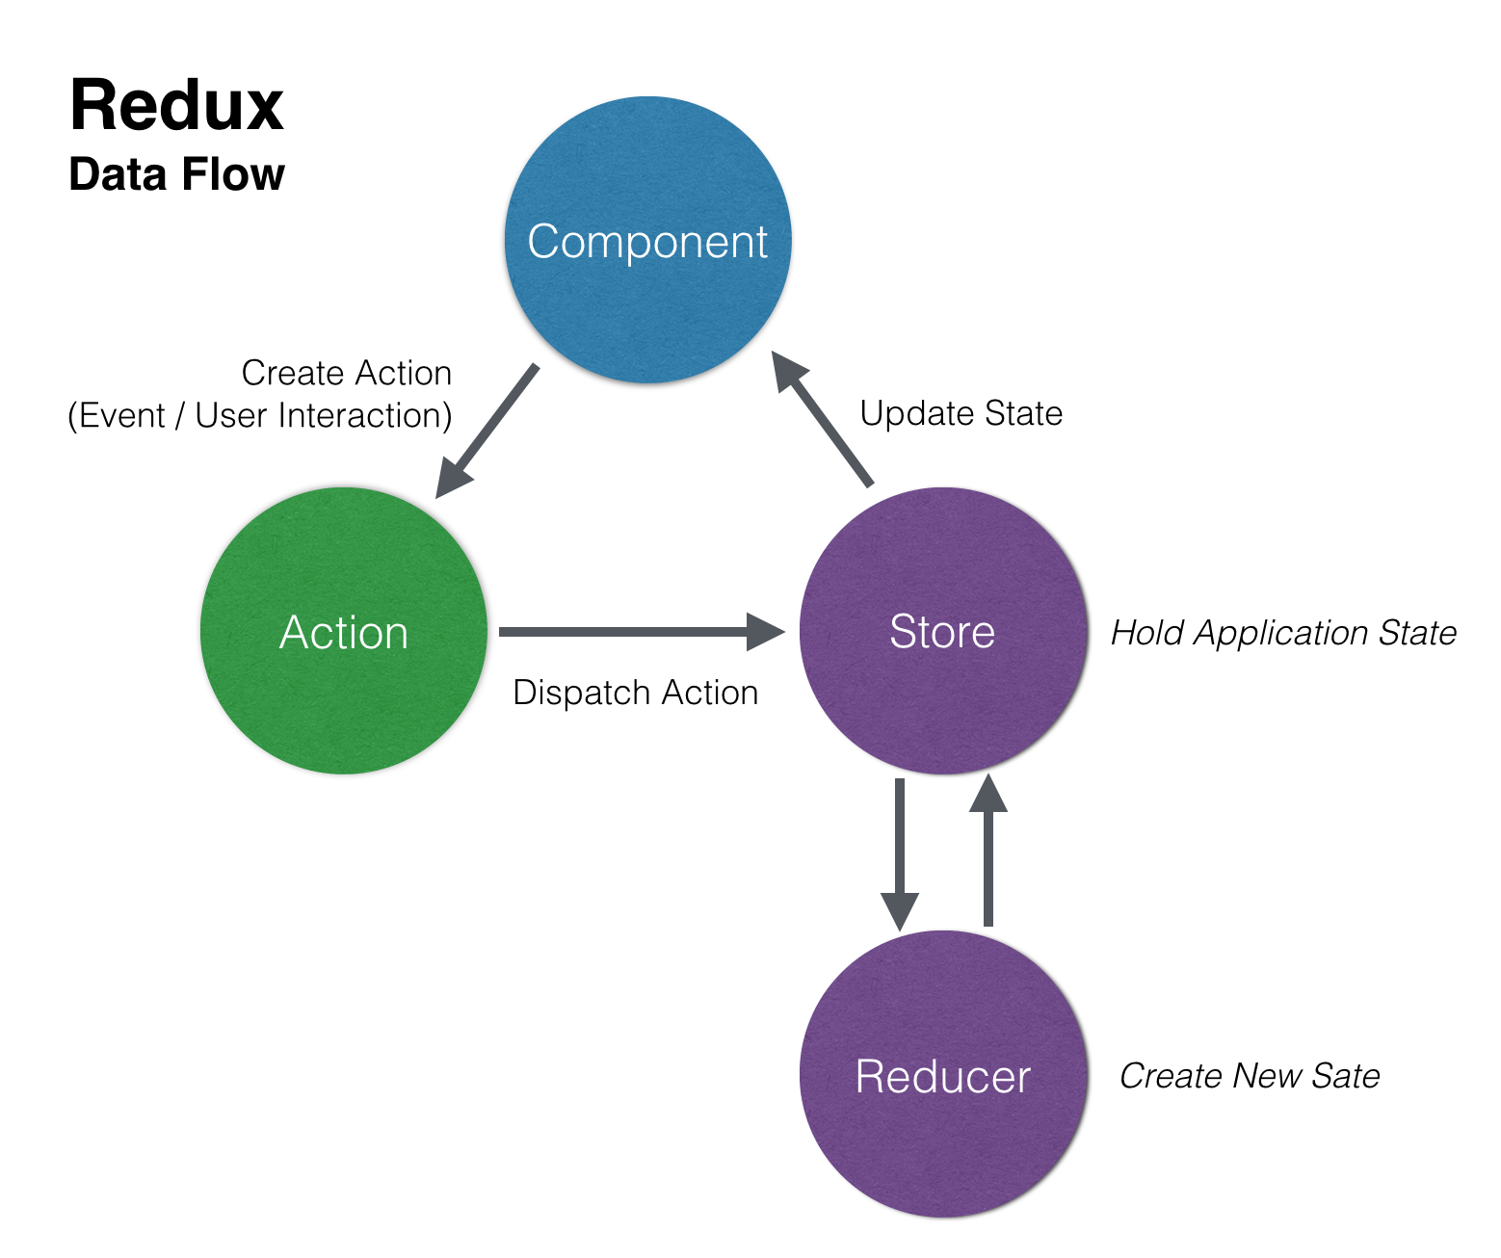
Redux Basic
Actions: (what happened)
Source of info
Send data app to store
JS Object, has ‘type‘
store.dispatch()
Action Creator: Function that create& return action.
Reducers: (how happended/changes)
JS Function (state, action)
Return next state
(previousState, action) => newState

Slide 7
Redux Basic
Store: bridge of state and reducer
Hold app state
Allow access to state: getState()
Update state: dispatch(action)
Registers listeners: subscribe(listeners)

Slide 8
DEMO: Redux in react
npm i --save react-redux redux redux-thunk//install and save redux for react

Slide 9
NPM VS YARN and bower
NPM:
Node js package manager by Rebecca for JS
Yarn:
Made by facebook.
Bower: front end lib install css, js

